Slide 1
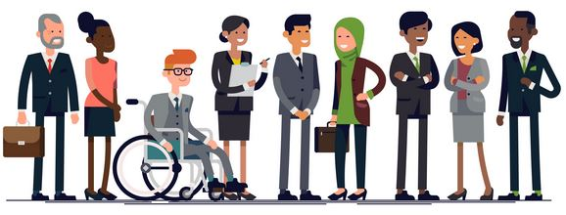
Embracing diversity in teams,
organization and society
Prof. Koliya Pulasinghe

Slide 2

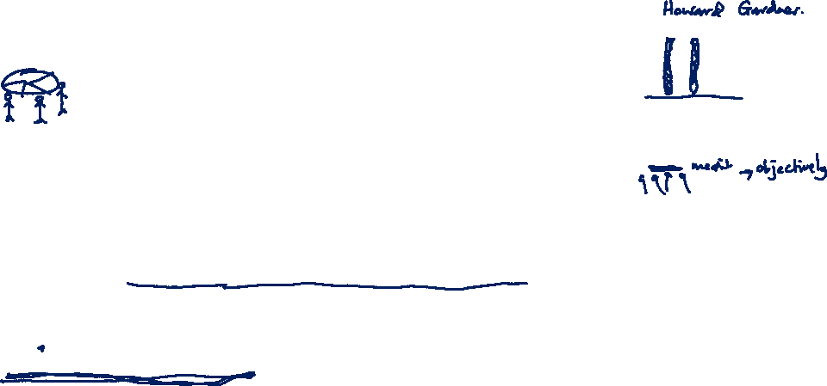
Embrace
Embrace: hold (someone) closely in one's arms, especially as a sign of affection
Inclusion is a sense of belonging. Inclusive cultures make people feel respected and valued for who they are as an individual or group.

Slide 3
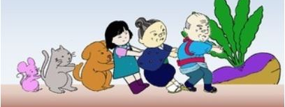

Team Diversity & Performance

Slide 4

What is team Diversity?
Team Diversity is the significant uniqueness of each individual on a team
This includes,
Religion
Gender
Age
Race
Also
Introverts
Extroverts
Liberals
Conservatives

Slide 5


Religious Diversity
Religion
It will bring lot of benefits by getting
many view points in decision making.
But this is the most challenging diversity aspect to handle.
It has to be effectively managed by:
Training all employees to educate company policy
Be fair in giving time for religious observations
Encourage employees to accept differences
Avoid overacting to simple things and not to tolerate serious issues

Slide 6

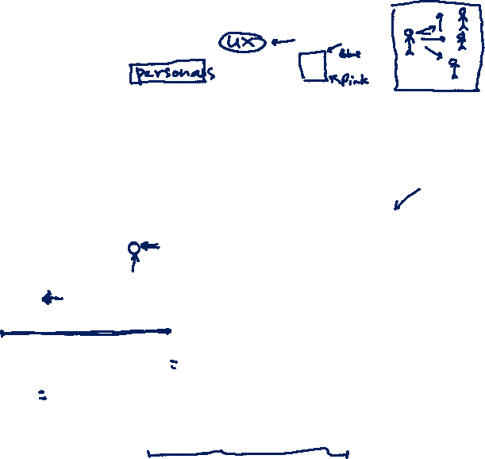
Gender Diversity
Gender
Gender Diversity offers many benefits such as:
Widen organization’s (team’s) talent pool
Bring multiple perspectives
Enhanced collaboration
Improve staff retention
Better understand customer needs
Improve organization’s (team’s) reputation
Gender communication issues can strongly affect team interactions.
Gender communication issues can range from communication styles and perceptions, opportunities and even sexual harassment.

Slide 7

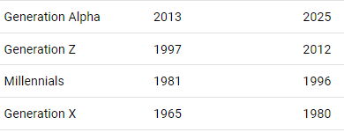
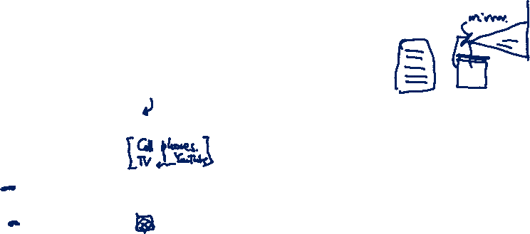
Age Diversity in a Team
Age Diversity
- Brings different mindsets, increase flexibility of team members, decisions are well rounded because of diversity in opinions, Mutually get trained, strengthen new ideas and fast execution, work-life balance

Slide 8


IMPORTANCE OF OLD WORKERS
1. Dedicated
2. Punctuality
3. Honesty
4. Detail-oriented,
5. Good listeners
6. Pride in a job
7. Organizational skills
8. Efficiency
9. Maturity
10. Communication skills
https://www.entrepreneur.com/article/167500

Slide 9

Why need young people
New energy and perspective
Young employees can bring fresh perspective and a different way of thinking to your business.
Workforce development
They have just come out of school or tertiary education they will still retain a mindset that will help them absorb training more readily.
Affordability
More often than not, wages for a young employee are less expensive than those for an older more experienced worker.
https://chessemployment.com.au/5-benefits-hiring-young-people/

Slide 10
Why need young people
Tech advancement & early adoption
Millennials have grown up around technology. Their natural affinity for tech and their ability to apply and understand different technologies quickly sets them apart from other generations in the workforce.
Adaptability & agility
When unexpected circumstances arise, younger people are better equipped to respond to sudden change . – Science Daily, 2011 .

Slide 11
Culture
Culture
Culture refers to the standards of social interaction, value and beliefs from a given group of people.
Cultural issues can affect team interactions through different understandings of communication or family and can appear to be an excuse for preferential treatment.

Slide 12
Race and Disabilities
Race
Race is defined as a group of people, often of a common geographic origin, that share genetically transmitted physical characteristics. Racism is the belief that these inherited characteristics affect an individual’s behavior or abilities.
Disabilities
Differences in ability often create difficulties in communication and emotional interactions. Whether it is a deaf individual not being able to communicate with hearing individuals, or a hearing individual being unsure of how to approach a deaf individual, disabilities present a variety of issues in team organizations

Slide 13

Benefits of Diversity in the Workplace
Here are a few of the top benefits or diversity in the workplace.
1) Talents, skills and experiences.
2) It creates innovation.
3) Language skills can open doors for a business.
4) It grows your talent pool.
5) Improves employee performance.

Slide 14

Challenges of Diversity in the Workplace
Discrimination
Stereotyping and preconception
High turnover rate
Absenteeism
Conflicts in team members
Increase tension
Productivity Decrease

Slide 15
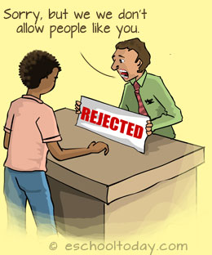
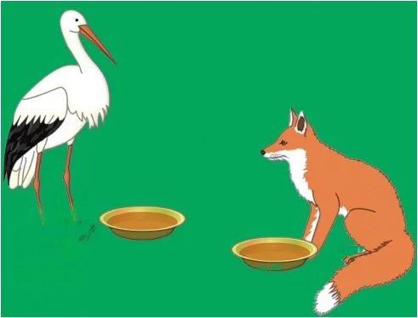

Discrimination
Discrimination means treating a person unfairly because of who they are or because they possess certain characteristics.
Age
Gender
Race
Disability
Religion
Pregnancy and maternity
Sexual orientation
Gender reassignment
Marriage and civil partnership

Slide 16

WHAT IS STEREOTYPING?
Stereotyping is defined as an "oversimplified, usually pejorative, attitude people hold toward those outside one's own experience who are different.”
A stereotype is simply a widely held belief that an individual is a member of a certain group based on characteristics.
Stereotypes are functional: As audience members we are bombarded with much more information than we can process.
Stereotypes are results of selectivity in social perception: We tend to see what we expect to see
Prejudice: This is the most influential factor in stereotyping. Our perceptions are highly subjective, and many people subscribe to derogatory descriptions of ethnic groups.

Slide 17
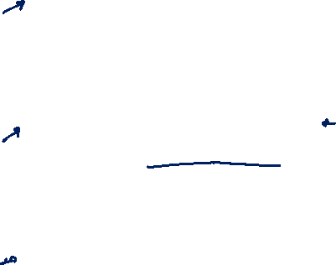
How to overcome diversity Issues:
Planning and Implementation
Business managers, must be able to plan and execute a diversity plan. This involves mapping out a way to create an appreciation for diversity in all employees in your office.
Conflict Resolution Skills
An essential tool to managing workplace diversity is the ability to handle conflict. Disagreements that arise because of cultural differences must be handled promptly and swiftly as to not decrease productivity in the workplace.
Communication
Good communication is one of the best ways to manage diversity in the workplace. Encourage your employees to share concerns as they arise. Every employee should feel equally important to the company.

Slide 18

Exercise:
Analyze your team based on factors like:
Gender
Religious belief
Those who attended to mixed schools, Girls/Boys schools
From Western Province, Outside
Discuss how you can get those differences for the benefit of project’s success
Write a reflective journal about one of the diversity experience or issue, you faced with your project team or in your life
Submit your assignment as a PDF on or before midnight 31st August, 2021.

